Slide 1
Indexing
MODULE III
Jacob P Cherian
Asst.Professor
Dept.of CSE, Saintgits College of Engineering

Slide 2
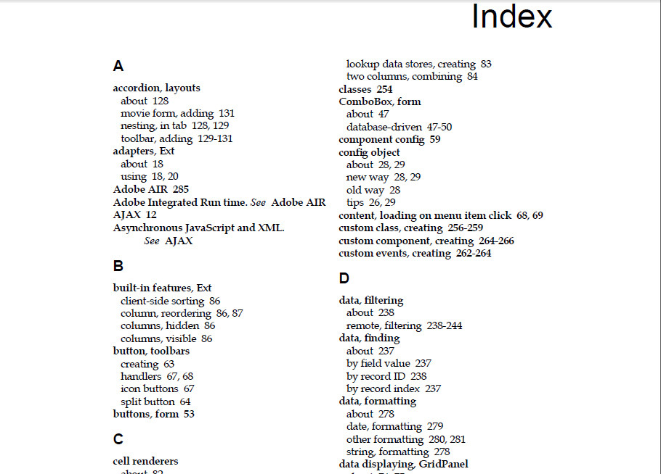
Why do we need Indexing
We can search the book index for a certain term in the textbook to find a list of addresses—page numbers in this case—and use these addresses to locate the specified pages first and then search for the term on each specified page.

Slide 3
Why do we need Indexing
For a file with a given record structure consisting of several fields (or attributes), an index access structure is usually defined on a single field of a file, called an indexing field (or indexing attribute).
The index typically stores each value of the index field along with a list of pointers to all disk blocks that contain records with that field value

Slide 4
Primary Index
A primary index is an ordered file whose records are of fixed length with two fields, and it acts like an access structure to efficiently search for and access the data records in a data file.
The first field is of the same data type as the ordering key field—called the primary key—of the data file, and the second field is a pointer to a disk block (a block address).

Slide 5
Primary Index
There is one index entry (or index record) in the index file for each block in the data file.
Each index entry has the value of the primary key field for the first record in a block and a pointer to that block as its two field values
The first record in each block of the data file is called the anchor record of the block, or simply the block anchor.

Slide 6
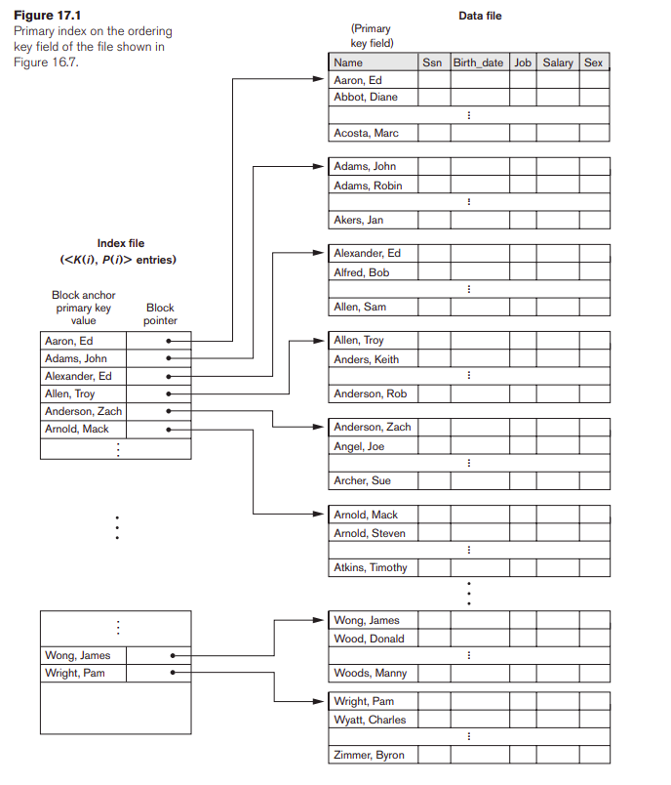
Primary Index
A dense index has an index entry for every search key value (and hence every record) in the data file.
A sparse (or nondense) index, on the other hand, has index entries for only some of the search values

Slide 7
Clustering Index
If file records are physically ordered on a nonkey field—which does not have a distinct value for each record—that field is called the clustering field and the data file is called a clustered file.

Slide 8
Clustering Index
We can create a different type of index, called a clustering index, to speed up retrieval of all the records that have the same value for the clustering field.
This differs from a primary index, which requires that the ordering field of the data file have a distinct value for each record.

Slide 9
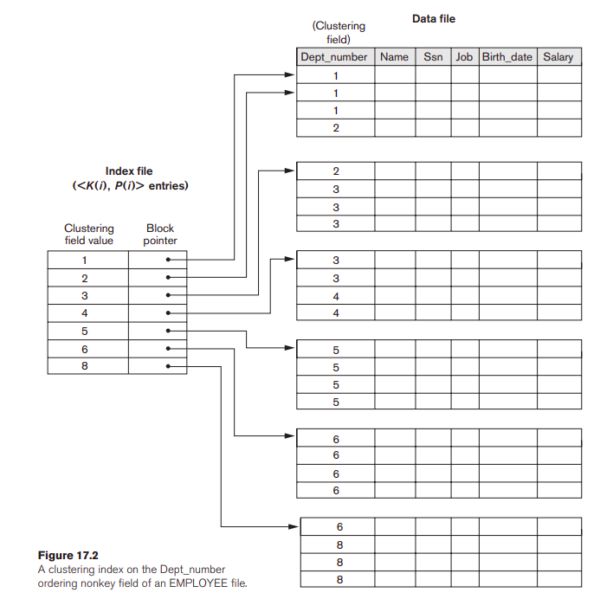
Clustering Index
A clustering index is another example of a nondense index because it has an entry for every distinct value of the indexing field, which is a nonkey by definition and hence has duplicate values rather than a unique value for every record in the file.

Slide 10
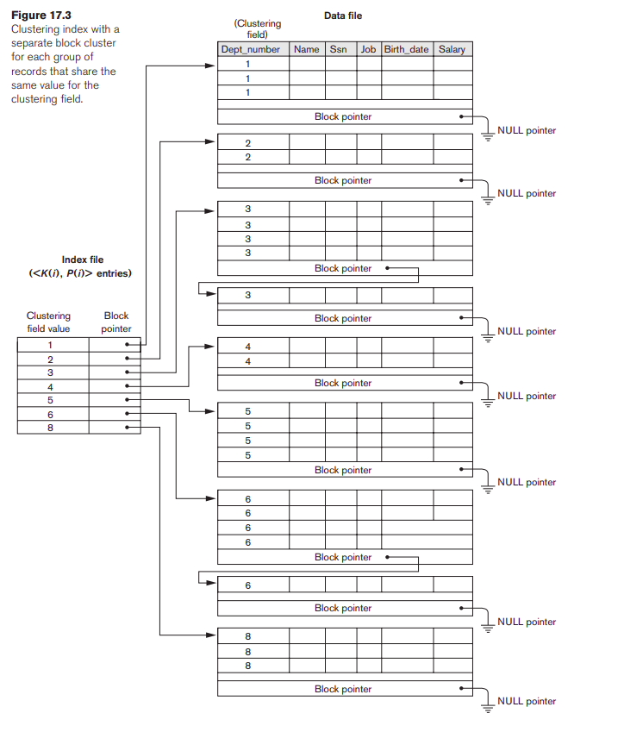
Clustering Index

Slide 11
Secondary Index
A secondary index provides a secondary means of accessing a data file for which some primary access already exists.
The secondary index may be created on a field that is a candidate key and has a unique value in every record, or on a nonkey field with duplicate values. The index is again an ordered file with two fields. T

Slide 12
Secondary Index
he first field is of the same datatype as some non-ordering field of the data file that is an indexing field. The second field is either a block pointer or a record pointer.
Many secondary indexes can be created for the same file.
Each represents an additional means of accessing that file based on some specific field.

Slide 13
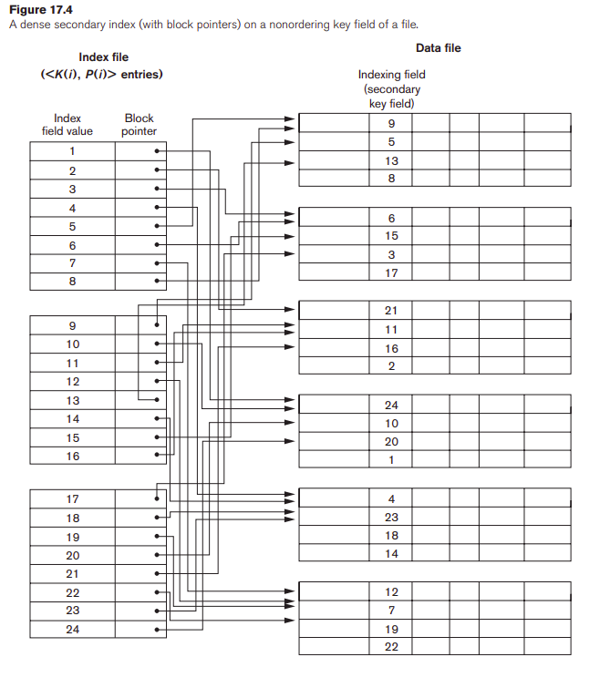
Secondary Index
A secondary index usually needs more storage space and longer search time than does a primary index, because of its larger number of entries.

Slide 14
Multilevel Indexing
Multi-level Index helps in breaking down the index into several smaller indices in order to make the outermost level so small that it can be saved in a single disk block, which can easily be accommodated anywhere in the main memory.

Slide 15
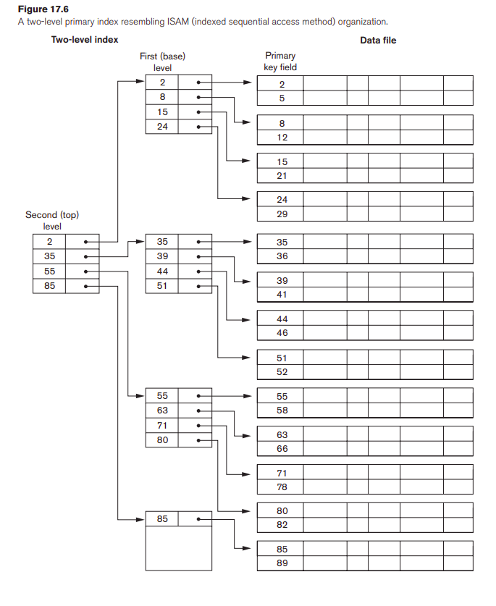
Multilevel Indexing

